Slide 1
Thyroid Hormone Circadian and Circannual Variation in 475,000 Outpatients.
Joel Ehrenkranz MD
Dept of Medicine, Intermountain Healthcare, Salt Lake City, UT, United States
Phillip R. Bach Ph.D.
Dept. of Pathology, Intermountain Central Laboratory, Salt Lake City, UT, United States
Salvatore Benvenga M.D.
Dept. of Clinical and Experimental Medicine, The University of Messina, Messina, Italy.
DISCLOSURE: nothing to disclose.

Slide 2
Thyroid Chronobiology: Prior Observations
Multiple studies have demonstrated a circadian variation in TSH and FT3.
JCEM 2008, 93(6):2300–2306
                Clinical Chemistry 53, No. 2, 2007
  Small sample size
  Short study duration
Many examples of seasonal variation in thyroid function and pathology:
  Thyroid volume Horm. Metabol. Res. 1987; 19: 391
  Radioactive iodine uptake JCEM. 1964; 24: 1084
  TSH, total and free T3 and T4 levels Am. J. Human Biology. 2006;18: 99. Eur J Nutr. 2011 50:285
  TSH response to TRH Ann Clinical Biochemistry 1985; 22: 371
  Seasonal alterations in T4 levels among Siberian miners
  Int. J. Circumpolar Health 1997; 56: 134
  Neonatal TSH PLOS ONE 2012; 7: e47770. Clin Biochem. 2013;46:133-8
  Presentation of thyroid cancer British Journal of Cancer 1998 77, 1174.
We undertook a large scale retrospective analysis of temporal variation in thyroid hormone levels measured in a controlled and calibrated manner.

Slide 3
Methods and Materials
Data analysis extracted from Intermountain Healthcare (Salt LakeCity, Utah) Electronic Data Warehouse.
    Data collected 6/2010-5/2013
Serum TSH, FT4, FT3 measured by Abbott Architect immunoassay
  external controls performed daily
Subjects
  25% males, ages 0-103 years
  75% females, ages 0-105 years
  Outpatients
    Outpatient clinics
    Emergency departments
    Same day surgery centers
    Specimen collection from urban and rural clinics and hospitals throughout Utah and southern Idaho.
    Includes individuals on any thyroid medication
    Neonatal TSH screening not included.

Slide 4
Circadian Variation
N TSH and FT4: 205,53 FT3: 58,993

Slide 5
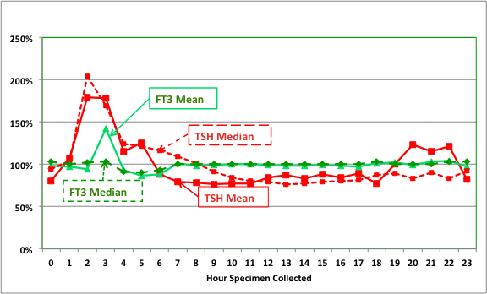
Normalized Circadian Variation in TSH and FT3

Slide 6
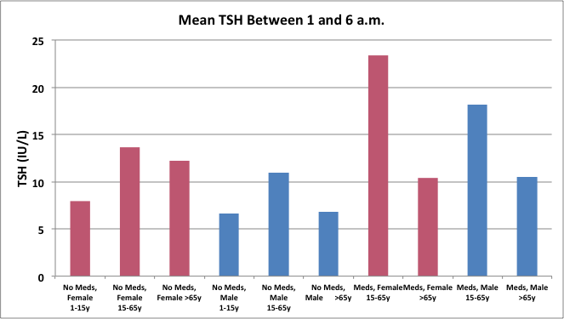
Nocturnal TSH Surge by Gender, Age, Rx

Slide 7
Circannual Variation
N TSH and FT4: 164,094 FT3: 47,667

Slide 8
Conclusions
TSH
  rises significant at night and remains constant between 6 AM and 7 PM.
  nocturnal surge varies by age and gender and is present independent of medication for thyroid disease.
  shows an inconsistent pattern of rising in November and December.
FT3
  peaks following the 2-3 AM rise in TSH.
  remains constant throughout the year.
FT4
  is constant throughout the 24 hour cycle.
  has no annual periodicity.
Clinical Implications
  Reference range for TSH needs to take into account time of day.
  Further studies are necessary to determine whether TSH has an annual rhythm and if monthly reference ranges are needed.
  A single measure of TSH between 6 AM and 7 PM as an indicator of TSH suppression may not be sufficient.

